Slide 1









Code&&Roses
CoReview

Slide 2

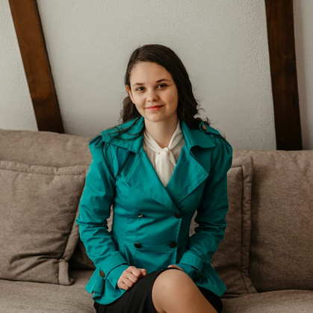
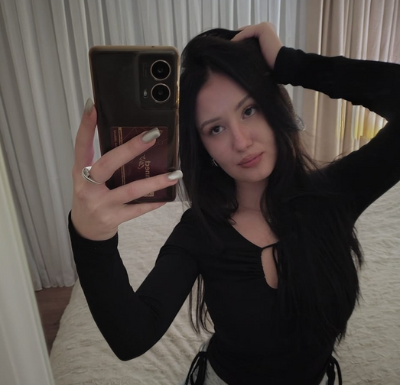
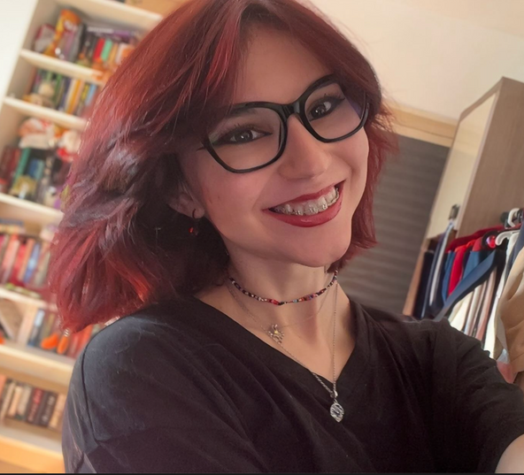

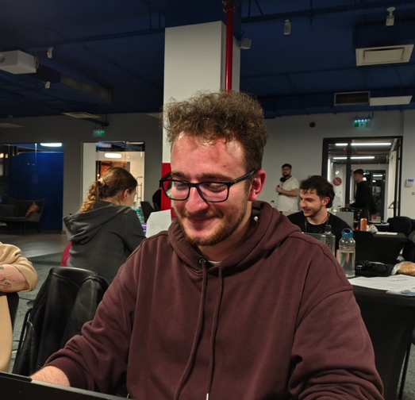
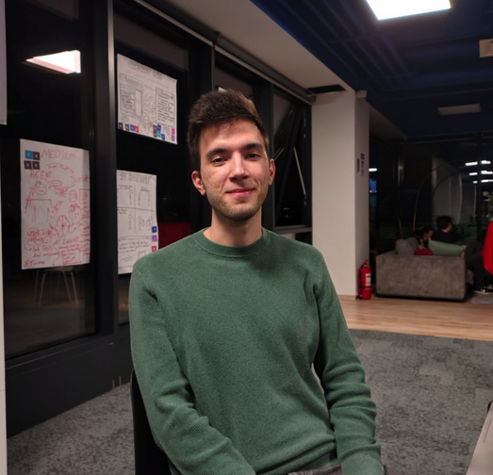
TEAM
MADALINA MERA
DENISA ZEPCIUC
AURA PANDOR
LUCIAN POPESCU
MARCUS COMAN

Slide 3




The problem we want to solve
People often struggle to get meaningful, timely feedback on their work.
There is no simple, centralized place where they can easily share projects and receive constructive input from others.

Slide 4


Our solution: An active learning ecosystem
We replace vague comments with "Pinpoint" markers. Students select the exact paragraph to critique, grounding every piece of feedback in context.
Safe, private sandboxes for cohorts to iterate on work. This removes the "fear of failure" associated with public platforms like GitHub.

Slide 5





Impact
Retention & Engagement
Job-Ready Soft Skills
Deep Mastery
Leveraging the "Giver Effect." Research shows students learn 20% more when they critique peers than when they just passively study alone.
Employers demand collaboration. We turn every assignment into a simulation of a real-world code review, building essential diplomacy skills.
Combating the isolation of remote learning. Our "Hubs" create the social glue that keeps students enrolled and engaged.

Slide 6

FUTURE IMPROVEMENTS
Smart Filtering: Automatically flags toxic or low-effort comments to ensure feedback remains constructive.
AI Moderation
Teacher dashboards for class management.
Assignment-style posts with deadlines.
Education Integration
Reputation/points system for helpful reviewers.
Higher XP boosts the visibility of the user's own posts
.
Community & Engagement

Slide 7


We move away from the isolated “submit and wait” approach and create an active community where students learn by giving and receiving feedback.
Demo

